Slide 1
Film Analytics
D A T A D A W G S
Siddhant Sutar, Dalton Childers, Neil Matin, Abhimanyu Tomar

Slide 2
TASKS
Siddhant: Machine learning model design and data mining
Dalton: Data acquisition and infrastructure
Neil: Documentation and machine learning research
Abhimanyu: Machine learning research

Slide 3
PROGRESS
Dataset: Movie data for ~1.1 million movies obtained from OMDb, stored in a csv file (size: ~500mb)
Machine learning model: Multiple linear regression

Slide 4
VARIABLES
Independent variables (features):
Rating (PG-13, R, etc.)
Genre(s)
Director(s)
Writer(s)
Actors
Dependent variable (outcome):
IMDb rating

Slide 5
MODEL
Since all the independent variables are categorical, not continuous, need to convert the categorical variables into a form that “makes sense” to regression analysis.
Basically need to numerically represent the categories of a variable, called dummy variables, data coded according to 0 and 1 scheme.
Interpretation: transform a variable such as Rating, which consists of categorical variables such as PG-13, R, etc. into a feature matrix with scores of 1 and 0 that can be analyzed with regression.

Slide 6
MODEL
Using Pandas get_dummies() function, create feature vectors for the independent variables: rating, genre(s), director(s), writer(s), actors. For example, a typical feature vector for actors would be a dataframe that would have movie IDs as rows and list of actors (from the movies in the dataset) as columns (dummy variables). If a specific actor was present in a specific movie, their intersection would have value 1; 0 otherwise.
Concatenate the feature vectors to the original dataframe which has the loaded csv data.

Slide 7

MODEL
Import scikit-learn module, instantiate the linear regression model and “fit” the x and y dataframes corresponding to the user-specified feature columns and the outcome prediction column.
For example, if the user entered “R”, “Quentin Tarantino”, “Leonardo DiCaprio” as the predictors, dataframe x would contain only those columns from the original dataset.
The x corresponds to x-axis which represents the independent variables, and the y corresponds to y-axis which represents the dependent variable in the following multiple linear regression equation:

Slide 8
MODEL
Since all the independent variables are categorical, this is also known as an analysis of variance (ANOVA).

Slide 9
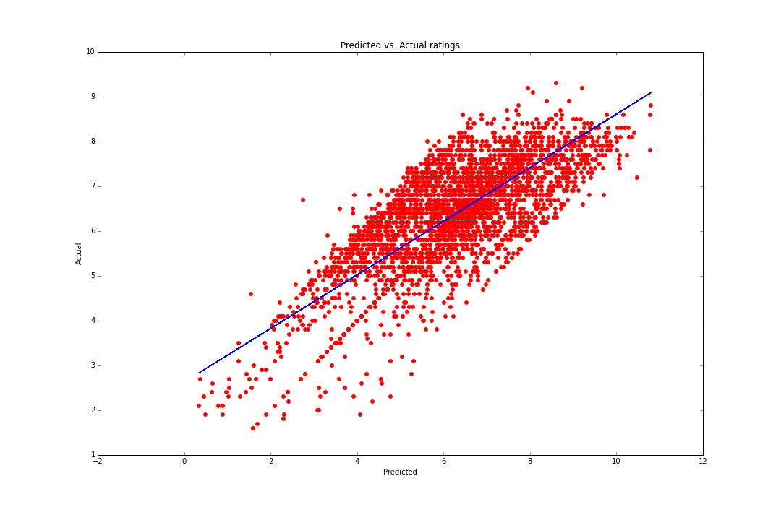
OBSERVATIONS

Slide 10
OBSERVATIONS
Scatter points closely lying around the line of best-fit (blue line), indicating a strong positive correlation between the actual ratings and the predicted ratings.
Root-mean-square error (RMSE): 0.8112

Slide 11
ISSUES
Scaling: the outcome rating with certain predictors crosses the 10 point mark
Memory management: since feature vectors are being created for categorical data, such as multiple actors, currently only considering movies above a certain threshold due to limited processing capabilities on a regular machine. The training dataset includes only movies with more than 1000 votes. (Movie count: 10200, director count: 4528, actor count: 15129)

Slide 12
FUTURE PLANS
Implement support for more features, more outcome predictors such as box office data: budget (feature), gross (outcome)
Currently working on parsing Rotten Tomatoes movie data to add more predictors such as production houses
Using box office data, analyze trends such as predicting the ideal time (month) for a movie release based on the budget and gross, showing a bar chart for the predicted box office collections depending upon the months

Slide 13
FUTURE PLANS
Improve memory handling to use more movies and actors, directors in the training dataset
Incorporate sentiment analysis on plot synopsis using naïve Bayes classification and Python’s NLTK library; movie plots with a rating of 7.5 are considered positive. Add plot keywords as predictor features
Look at other possible machine learning models, such as generalized additive model (GAM), and compare the results

